Slide 1

DataEngineer Challenge
For
Edward HO

Slide 2
Analyze Goals
From our web server (https://paytm.com) access log
Q1: What web pages are customers’ visiting?
Q2: How long for customers stay in our web pages?
Q3: Which web page is most attractive for our customers?
Q4: Who is our biggest FANS?

Slide 3






Data Pipeline
Let’s assume we are running in Microsoft Azure cloud environment
NSG
HTTP/HTTPS
Customers
Application Gateway
Private network
mounted
mounted
Storage Account
Data Analyst / Scientist

Slide 4
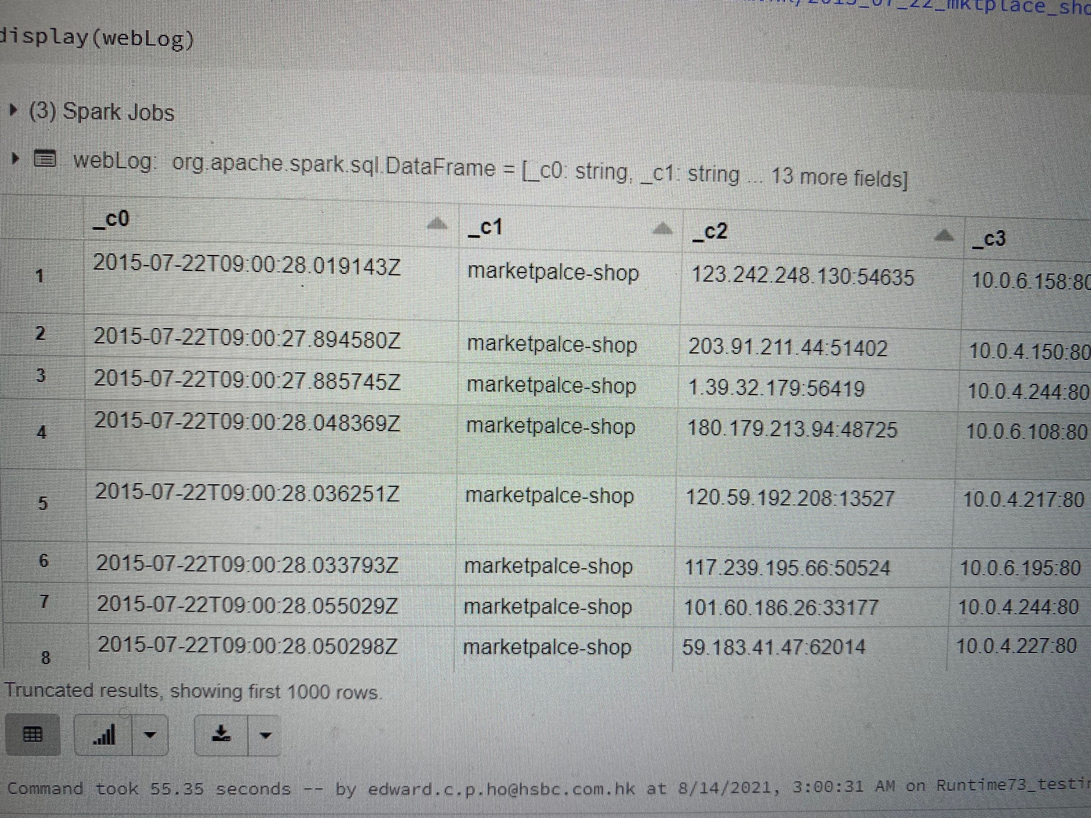
Data Preparation
Unzip the stored web log
gunzip /mnt/apache_web_log/2015_07_22_mktplace_shop_web_log_sample_log.gz
Create a dataframe “webLog” which load from unzipped file
val weblog = spark.read.format(“csv”)
.option(“header”, “false”)
.option(“inferSchema”, “true”)
.option(“delimiter”, “ “)
.load(“/Data/weblog/201507/2015_07_22_mktplace_shop_web_log_sample_log”)

Slide 5
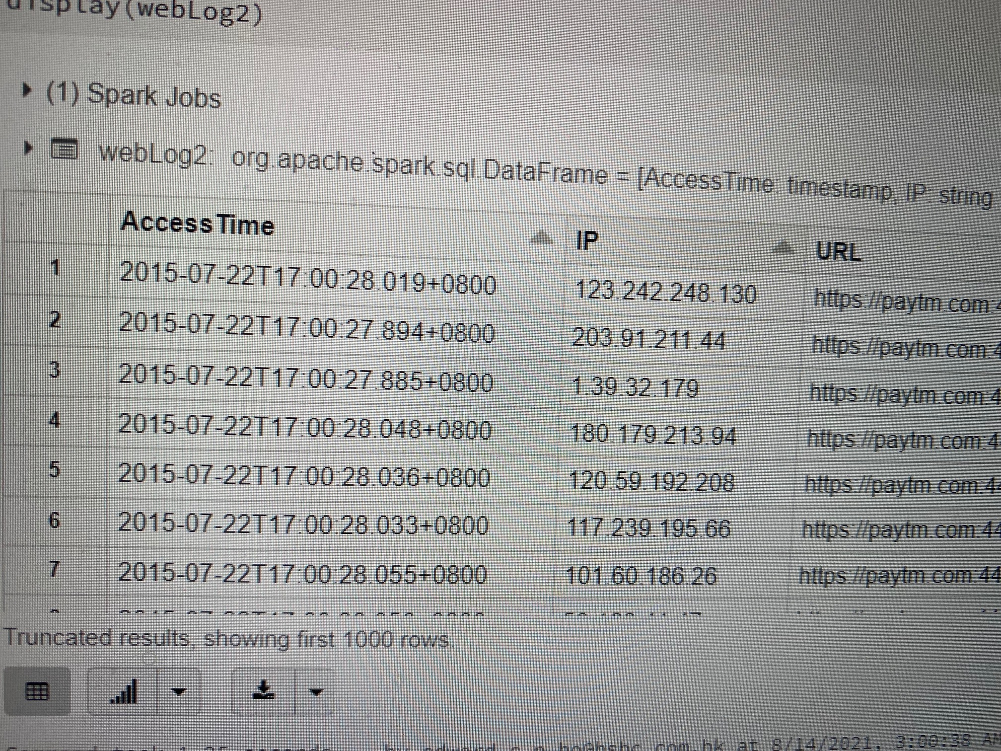
Data Preparation
Create Datamart which for analytic purpose
val webLog2 = webLog.select(
to_timestamp($”_c0”).alias(“AccessTime”),
split($”_c2”, “:”)(0).alias(“IP”),
split(split($”_c11”, “ “)(1), “\\?”)(0).alias(“URL”)
)

Slide 6
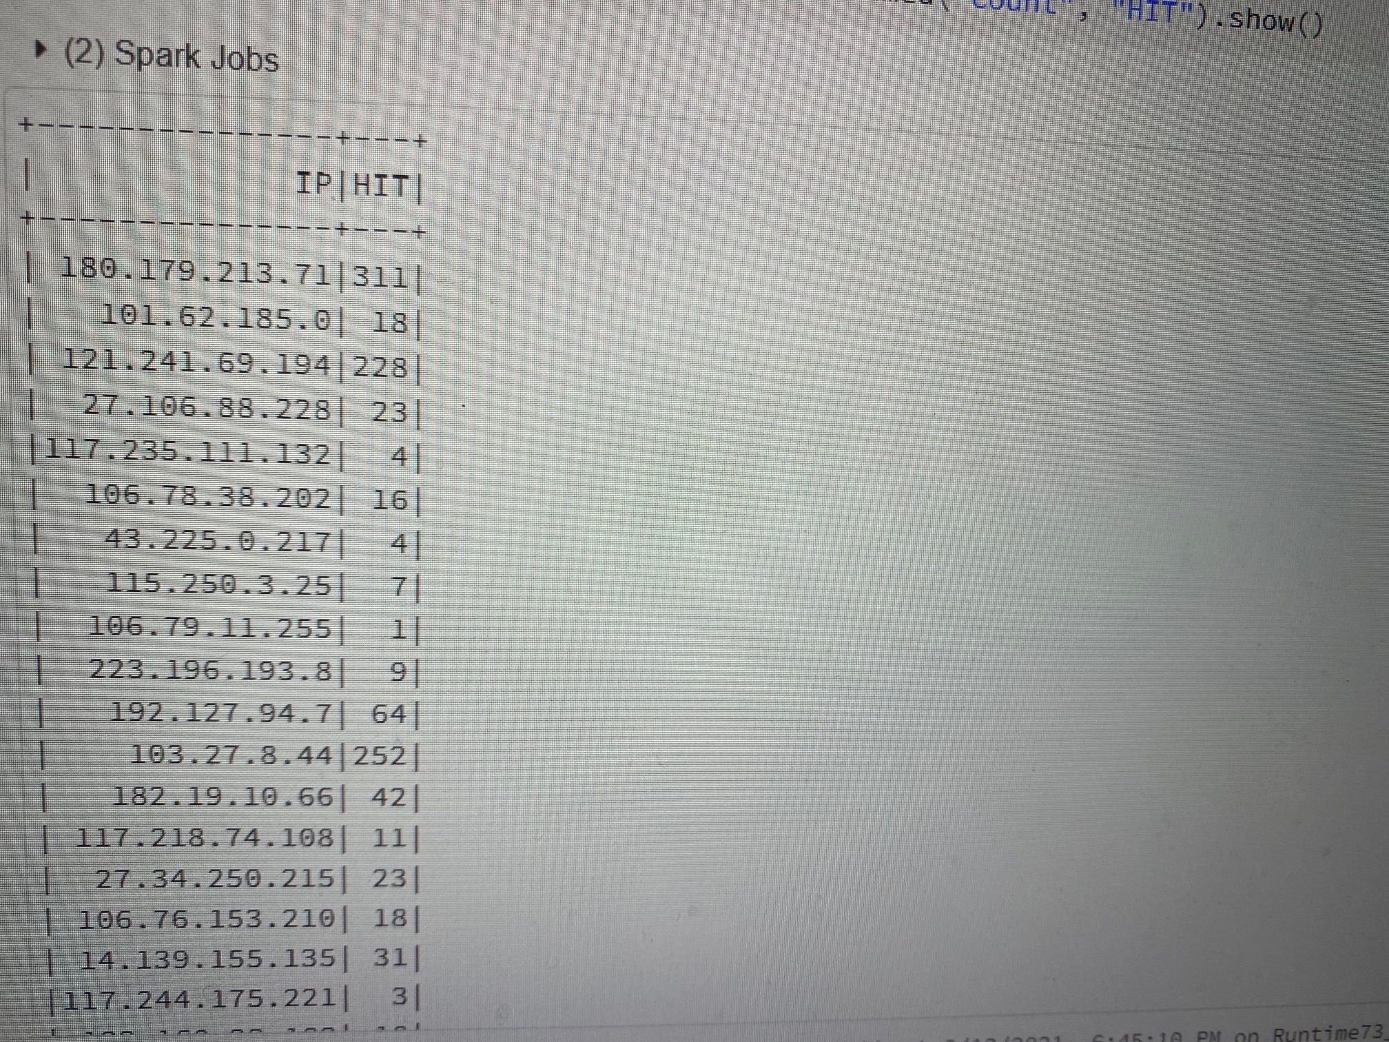
Analyst result
1. Sessionize the web log by IP. Sessionize = aggregrate all page hits by visitor/IP during a session.
webLog2.groupBy($”IP”).count().withColumnRenamed(“count”, “HIT”).show()

Slide 7
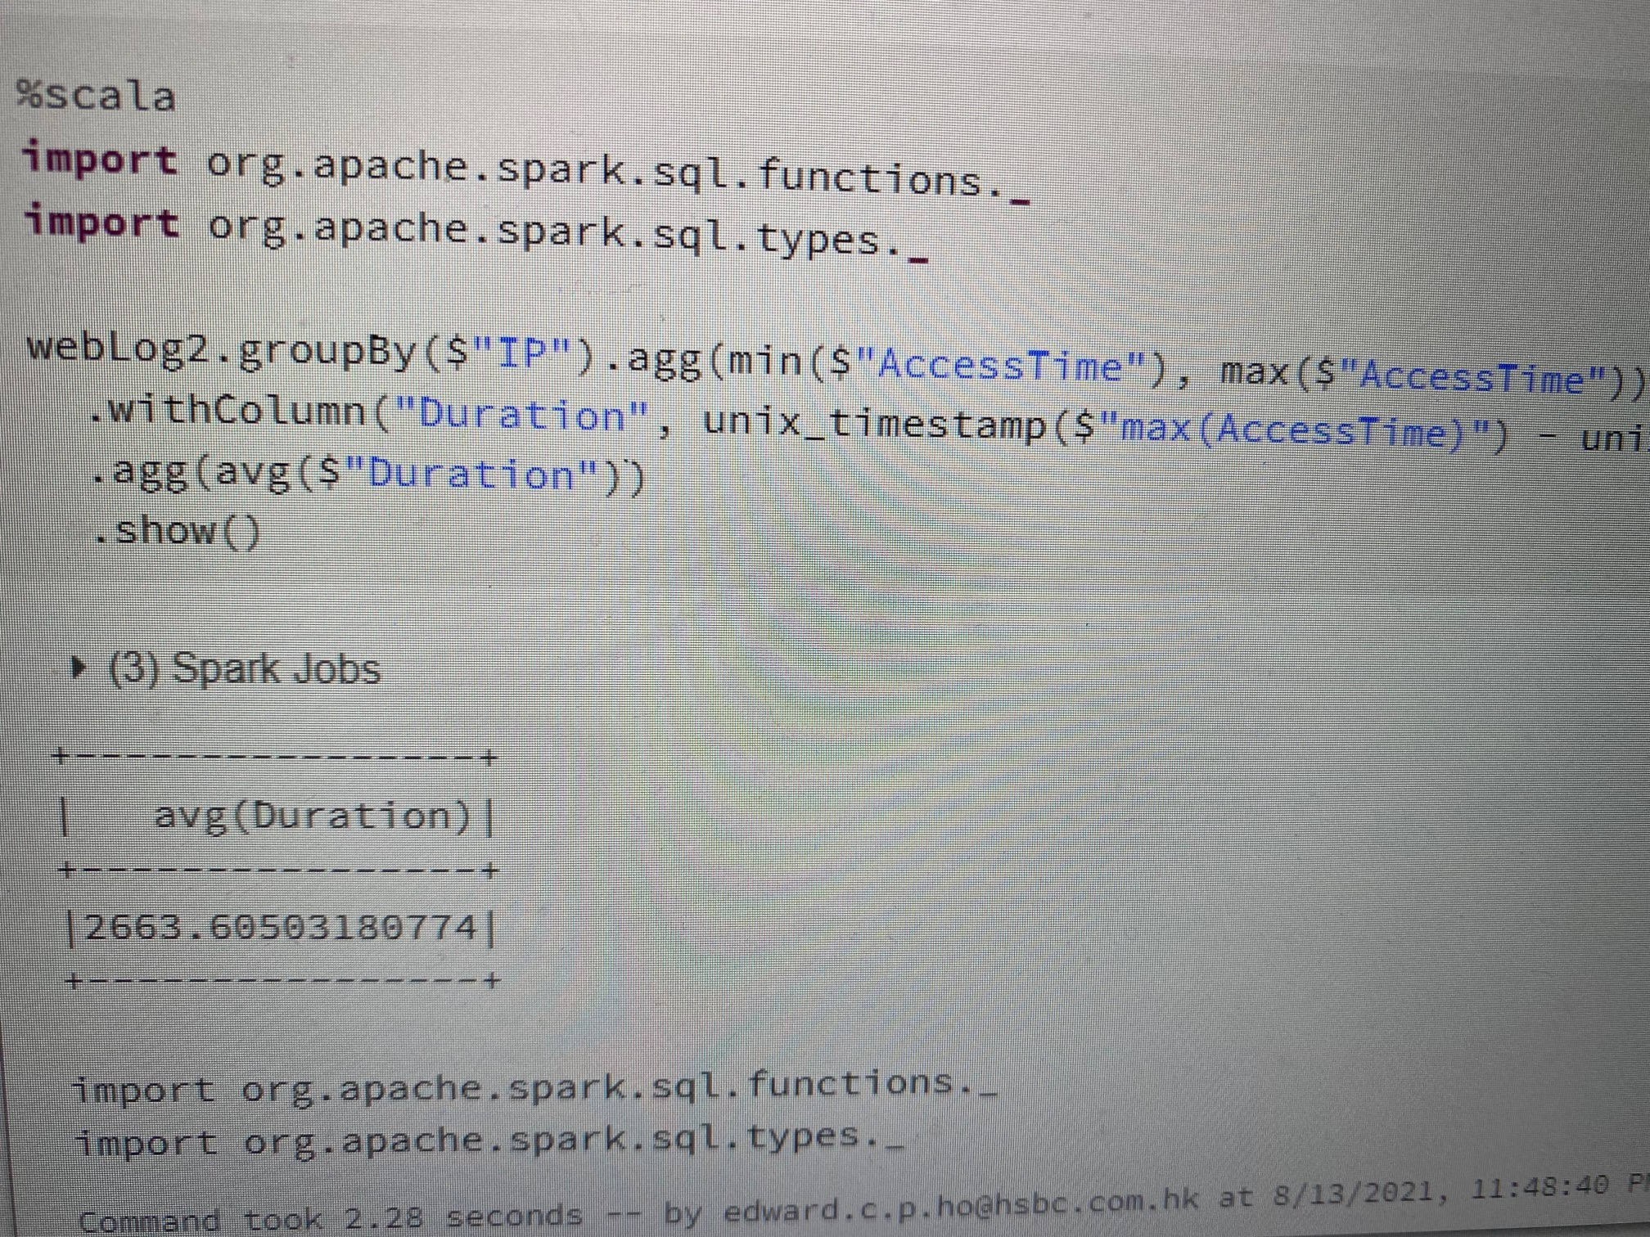
Analyst result
2. Determine the average session time
import org.apache.spark.sql.functions._
import org.apache.spark.sql.types._
webLog2.groupBy($”IP”).agg(min($”AccessTime”), max($”AccessTime”))
.withColumn(“Duration”, unix_timestamp($”max(AccessTime)”) –
unix_timestamp($”min(AccessTime)”))
.agg(avg($”Duration”))
.show()

Slide 8
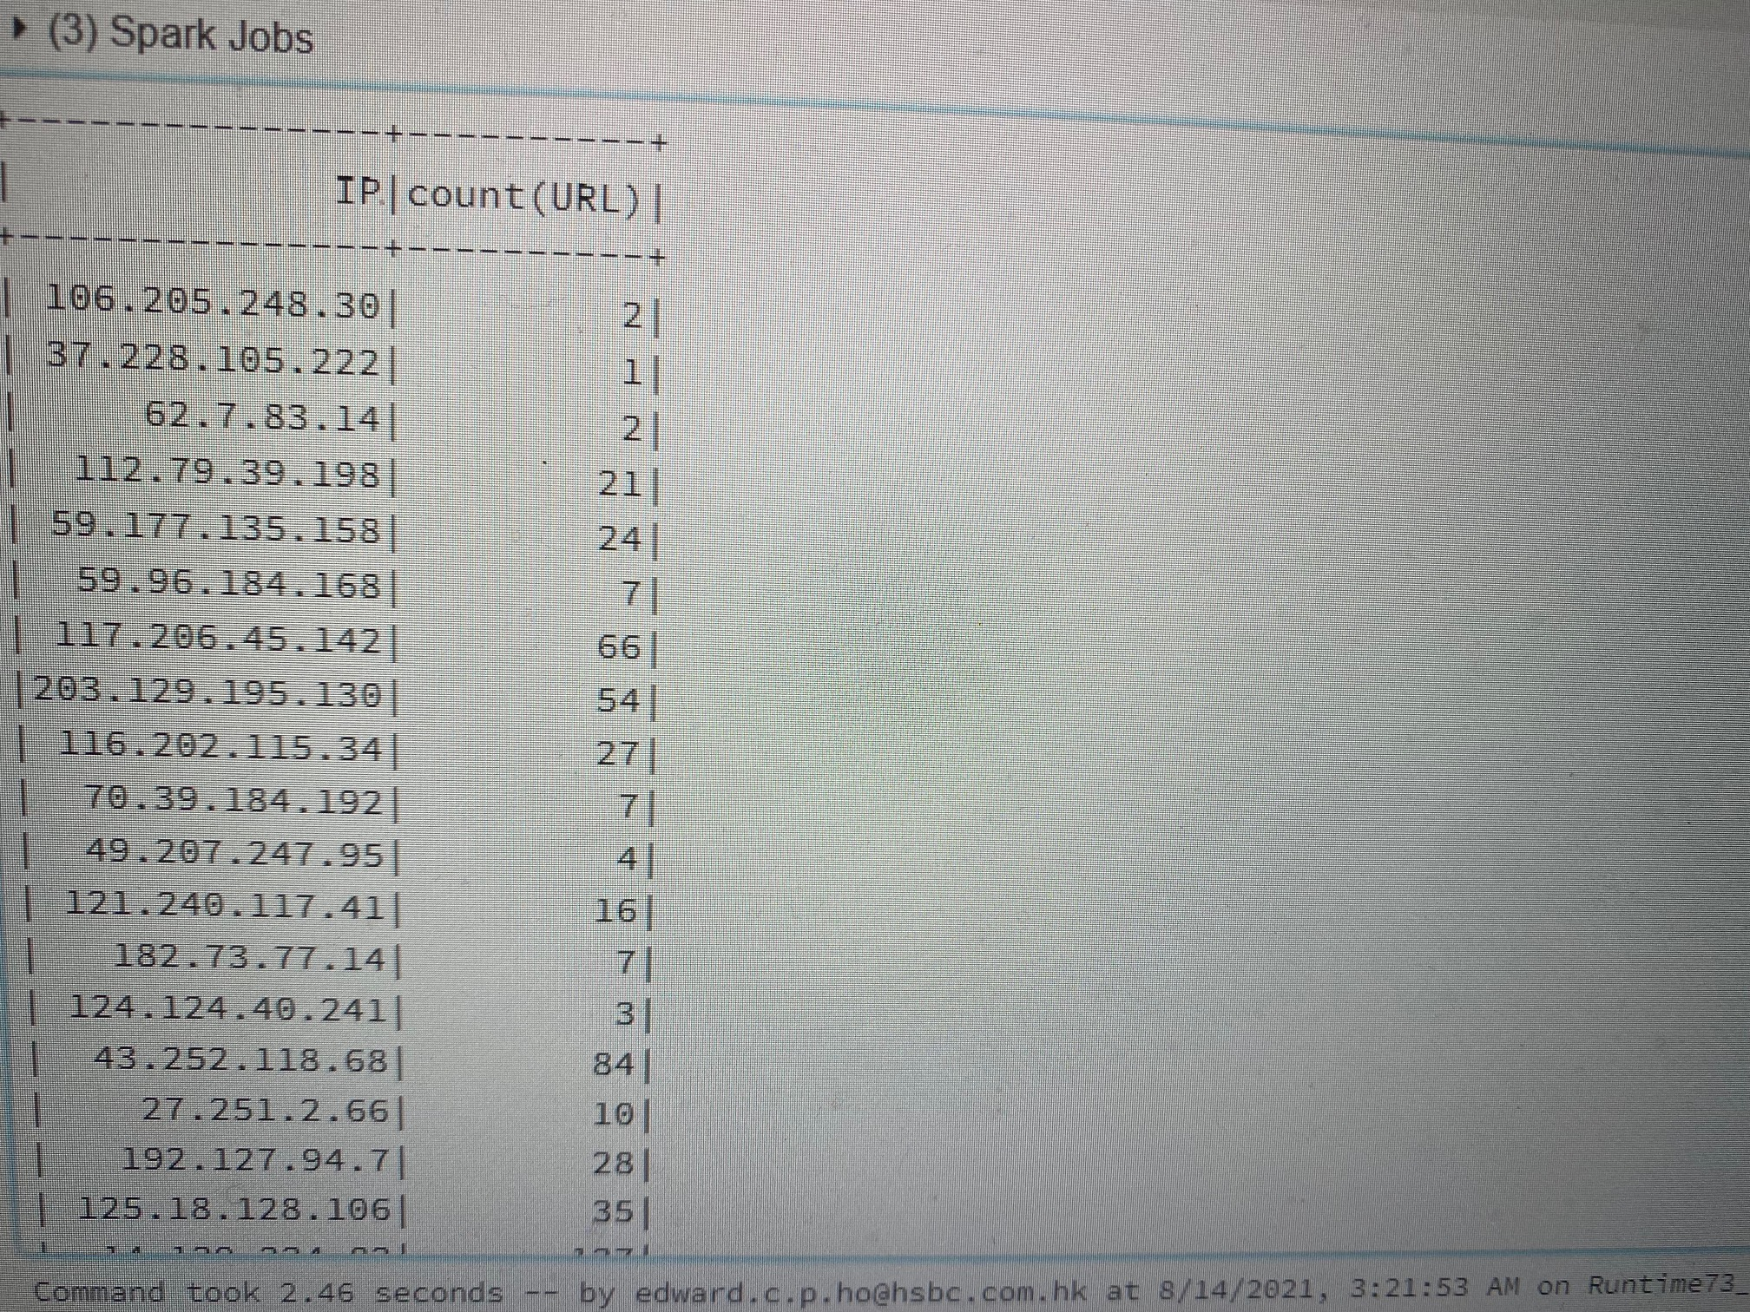
Analyst result
3. Determine unique URL visits per session. To clarify, count a hit to a unique URL only once per session.
webLog2.groupBy($”IP”).agg(countDistinct($”URL”)).show()

Slide 9
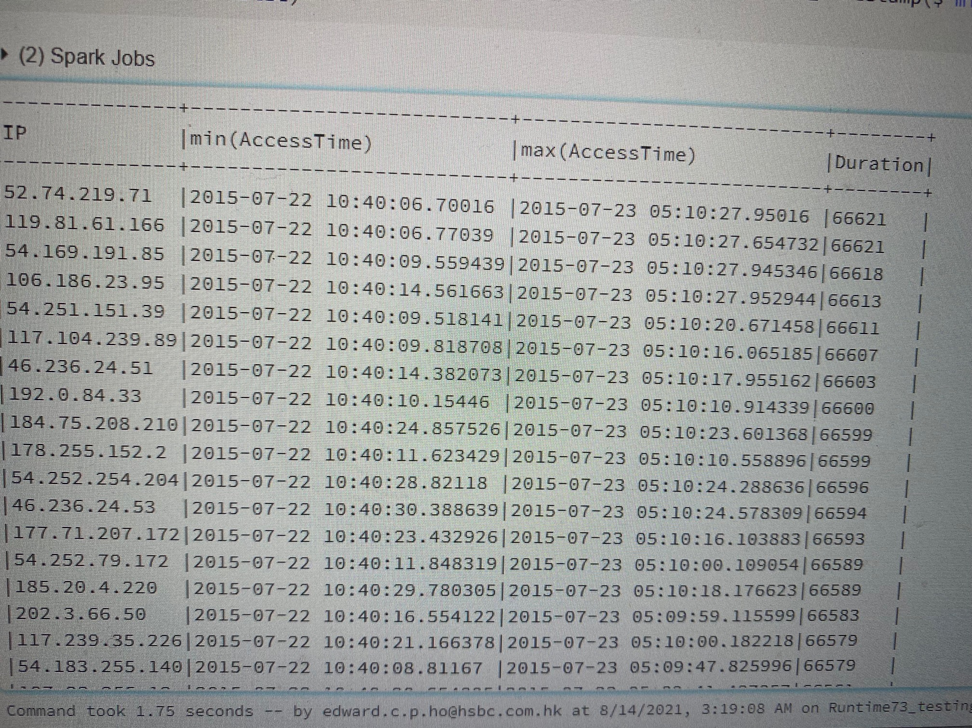
Analyst result
4. Find the most engaged users, ie the IPs with the longest session times
webLog2.groupBy($”IP”).agg(min($”AccessTime”), max($”AccessTime”))
.withColumn(“Duration”, unix_timestamp($”max(AccessTime)”) –
unix_timestamp($”min(AccessTime)”)).sort(desc(“Duration”))
.show(truncate = false)

Slide 10
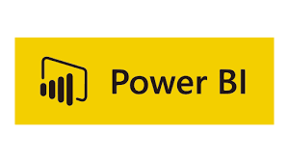



What’s more?
We can use Databricks as a data store and connect with other reporting tools
NSG
HTTP/HTTPS
Customers
Application Gateway
Private network
mounted
mounted
JDBC
Storage Account
Data Analyst / Scientist
Business users
(MI reporting)

Slide 11

And?
Use Fingerprinting / tagging to keep track on more user behavior. i.e. Streaming user actions to Databricks.
NSG
HTTP/HTTPS
Customers
EventHub
Application Gateway
Private network
mounted
mounted
JDBC
Storage Account
Data Analyst / Scientist
Business users
(MI reporting)

Slide 12
BENEFITS
Events tracking
Journey analyst
Enhance web site design
Understood customer behavior
Target marketing
So on…

Slide 13
Q & A
Thank you!
ありがとうございました。

